Slide 1
CSCI3170 Introduction to Database Systems
Tutorial 5 – Connect to MySQL Database, Run MySQL in Java

Slide 2
Items to Learn
CSE VPN
Connect to Linux Servers
Connect to your MySQL Database
In terminal
In java
Run MySQL Statement in Java

Slide 3
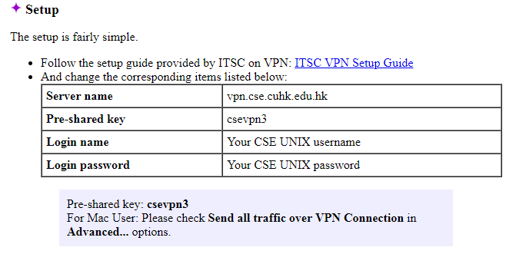
1.CSE VPN
Similar to CUHK VPN, except:

Slide 4
2.Connect to Linux Servers
Host Name: linux1.cse.cuhk.edu.hk
Port: 22
For Linux System, just type in the terminal:
For other system, may need some tools.
ssh linux1.cse.cuhk.edu.hk –p 22 -l username
Git Bash
Putty
SSH Secure Shell

Slide 5
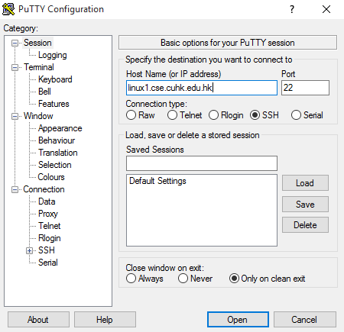
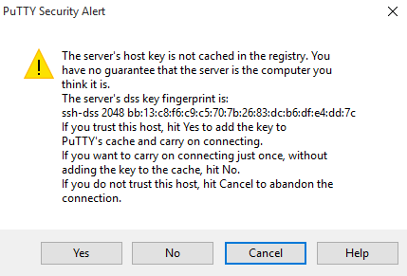
Connect to Linux Servers via Putty (1)
Click “Yes” if this window appears

Slide 6
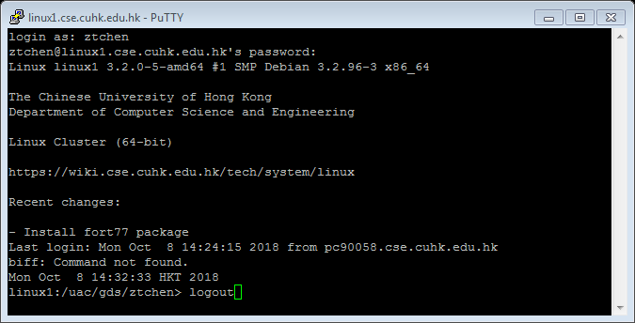
Connect to Linux Servers via Putty (2)
Type the “username” and “password” of your CSE Linux/Windows Account. Then press “enter”
For the sake of security, our CSE Linux server will not show **** while you are typing a password.
Type logout or exit to quit.

Slide 7
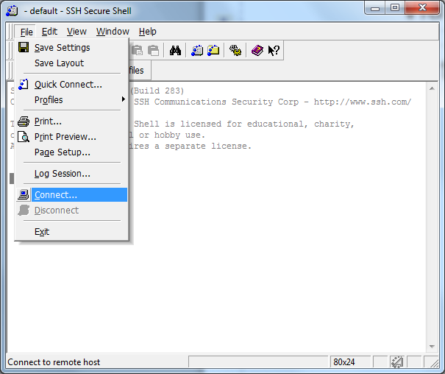
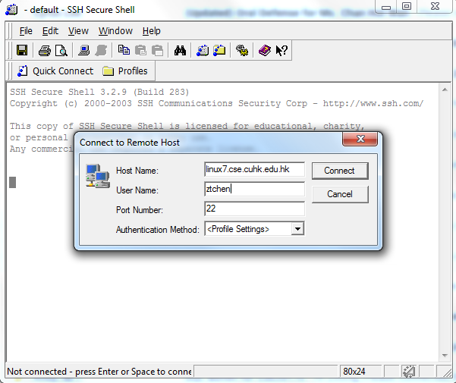
Connect to Linux Servers via SSH Secure Shell (1)

Slide 8
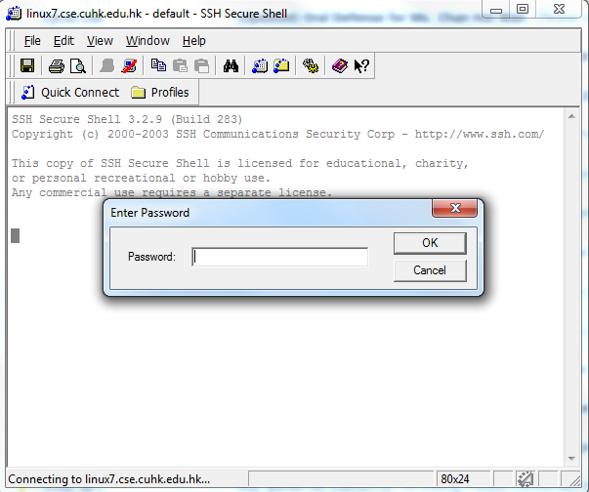
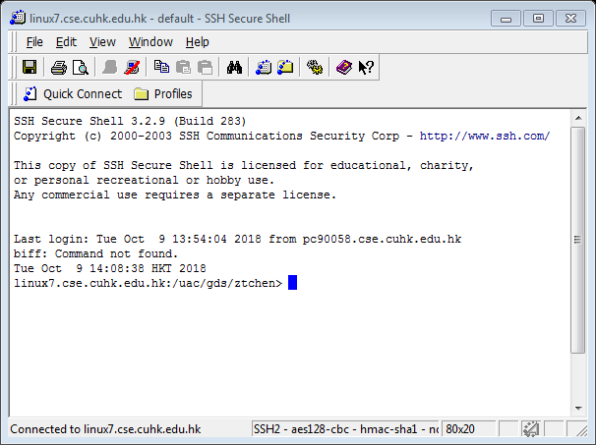
Connect to Linux Servers via SSH Secure Shell (2)

Slide 9
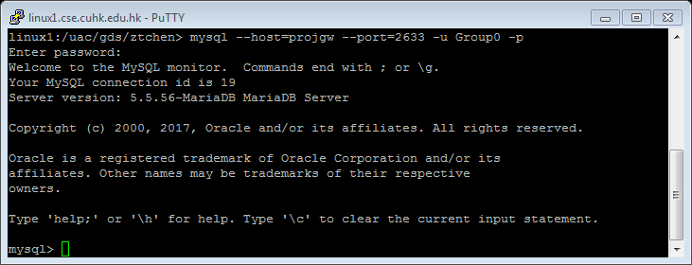
3.Connect to MySQL(In terminal)
After you login successfully, type:
to access MySQL using your MySQL account.
mysql --host=projgw --port=2633 -u username –p
username is your group name,
e.g. Group11 , Random2
default password: CSCI3170

Slide 10
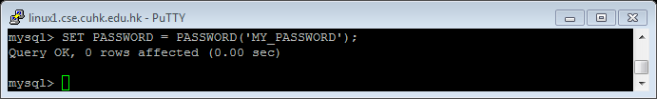
Change Password
Change password of logged in user
Please make sure your groupmates know the password
SET PASSWORD = PASSWORD(‘YOUR_PASSWORD’);

Slide 11

Use your database
Switch to the database
USE <your_database>;
database e.g. db11 , Rdb2
db11 is for Group11,
Rdb2 is for Random2.

Slide 12
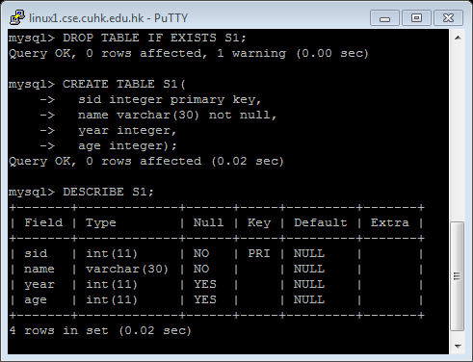
Run MySQL Statements
(Pre-cautionary) dropping the table
Create Table
Show the table schema
DROP TABLE IF EXISTS S1;
CREATE TABLE S1(
sid integer primary key,
name varchar(30) not null,
year integer,
age integer);
DESCRIBE S1;

Slide 13
3.Connect to MySQL(In Java)
Download and unzip to get “mysql-connector-java-version.jar”
When running your java code, include the path of “mysql-connector-java-version.jar”
java –cp .:path_to_connector 3170proj

Slide 14
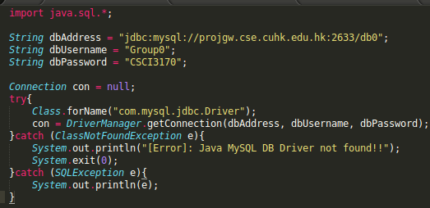
3.Connect to MySQL(In Java)
More Detail can be found in Connecting to MySQL Using the JDBC DriverManager Interface.

Slide 15
4.Run MySQL Statement in Java
Method 1:(Statement)
String sql = ***;
Connection con= ***;
Statement stmt = con.createStatement();
For sql involved create, insert, update, drop, delete:
stmt.executeUpdate(sql);
For select query:
ResultSet rs = stmt.executeQuery(sql);
More details can be found in Using JDBC Statement Objects to Execute SQL

Slide 16
For statement with Parameters
String sql = "SELECT * FROM student WHERE age = %s and gender = ‘%s’;"
String aUserInputAge = ***;
String aUserInputGender = ***;
sql = String.format(sql, aUserInputAge, aUserInputGender);
Connection con= ***;
Statement stmt = con.createStatement();
ResultSet resultSet = stmt.executeQuery(sql);
If you write gender = %s here,
then your sql statement may be:
SELECT * FROM student
WHERE age = 20 and gender = male;
Notice that male is regarded as a column name instead of a string value.

Slide 17
4.Run MySQL Statement in Java
Method 2:(PreparedStatement)
String psql = "SELECT * FROM student WHERE age = ? and gender = ? ;"
String aUserInputAge = ***;
String aUserInputGender = ***;
Connection conn= ***;
PreparedStatement pstmt = conn.prepareStatement(psql);
pstmt.setInt(1, Integer.parseInt(aUserInputAge));
pstmt.setString(2, aUserInputGender);
ResultSet resultSet = pstmt.executeQuery();
More details can be found in PreparedStatement interface

Slide 18
Output records in ResultSet
String sql = “SELECT name, age FROM student; ”
…….
ResultSet resultSet = stmt.executeQuery(sql);
if(!resultSet.isBeforeFirst())
System.out.println("No records found.");
else
while(resultSet.next()){
System.out.print(resultSet.getString(1));
System.out.print(resultSet.getInt(“age”));
}
More details can be found in JDBC: ResultSet.
Either column index or column name is OK.

